Slide 1
Intermediate Code Generation

Slide 2
Intermediate Code Generation
Intermediate languages
Runtime environments
Declarations
Expressions
Statements

Slide 3
Intermediate Languages
a := b * - c + b * - c
Syntax tree
Postfix notation
a b c - * b c - * + :=
Three-address code
:=
a
+
*
*
b
-
b
-
c
c

Slide 4
Three-Address Code
x := y op z
Where x, y, z are names, constants, or temporaries
x + y * z
t1 := y * z
t2 := x + t1
a := b * -c + b * -c
t1 := -c
t2 := b * t1
t3 := -c
t4 := b * t3
t5 := t2 + t4
a := t5

Slide 5
Types of Three-Address Code
Assignment statement x := y op z
Assignment statement x := op y
Copy statement x := y
Unconditional jump goto L
Conditional jump if x relop y goto L
Procedural call param x
call p, n
return y

Slide 6
Types of Three-Address Code
Indexed assignment x := y[i]
x[i] := y
Address and pointer assignment
x := &y
x := *y
*x := y

Slide 7
Implementation of Three-Address Code
Quadruples
op arg1 arg2 result
(0) - c t1
(1) * b t1 t2
(2) - c t3
(3) * b t3 t4
(4) + t2 t4 t5
(5) := t5 a

Slide 8
Implementation of Three-Address Code
Triples
op arg1 arg2
(0) - c
(1) * b (0)
(2) - c
(3) * b (2)
(4) + (1) (3)
(5) := a (4)

Slide 9
Implementation of Three-Address Code
Indirect Triples
statement op arg1 arg2
(0) (14) (14) - c
(1) (15) (15) * b (14)
(2) (16) (16) - c
(3) (17) (17) * b (16)
(4) (18) (18) + (15) (17)
(5) (19) (19) := a (18)

Slide 10
Comparison
Qualdruples
  direct access of the location for temporaries
  easier for optimization
Triples
  space efficiency
Indirect Triples
  easier for optimization
  space efficiency

Slide 11
Runtime Environments
A translation needs to relate the static source text of a program to the dynamic actions that must occur at runtime to implement the program
Essentially, the relationship between names and data objects
The runtime support system consists of routines that manage the allocation and deallocation of data objects

Slide 12
Activations
A procedure definition associates an identifier (name) with a statement (body)
Each execution of a procedure body is an activation of the procedure
An activation tree depicts the way control enters and leaves activations

Slide 13
An Example
program sort (input, output);
var a: array [0..10] of integer;
procedure readarray;
var i: integer;
begin for i := 1 to 9 do read(a[i]) end;
procedure partition(y, z: integer): integer;
var i, j, x, v: integer;
begin … end;
procedure quicksort(m, n: integer);
var i: integer;
begin if (n > m) then begin
I := partition(m, n); quicksort(m, I-1); quicksort (I+1, n)
end end;
begin a[0] := -9999; a[10] := 9999; readarray; quicksort(1,9) end.

Slide 14
An Example
s
r
q(1,9)
p(1,9)
q(1,3)
q(5,9)
p(1,3)
q(1,0)
q(2,3)
p(5,9)
q(5,5)
q(7,9)
p(2,3)
q(2,1)
q(3,3)
p(7,9)
q(7,7)
q(9,9)

Slide 15
Scope
A declaration associates information with a name
Scope rules determine which declaration of a name applies
The portion of the program to which a declaration applies is called the scope of that declaration

Slide 16
Bindings of Names
The same name may denote different data objects (storage locations) at runtime
An environment is a function that maps a name to a storage location
A state is a function that maps a storage location to the value held there
environment
state
name
storage location
value

Slide 17
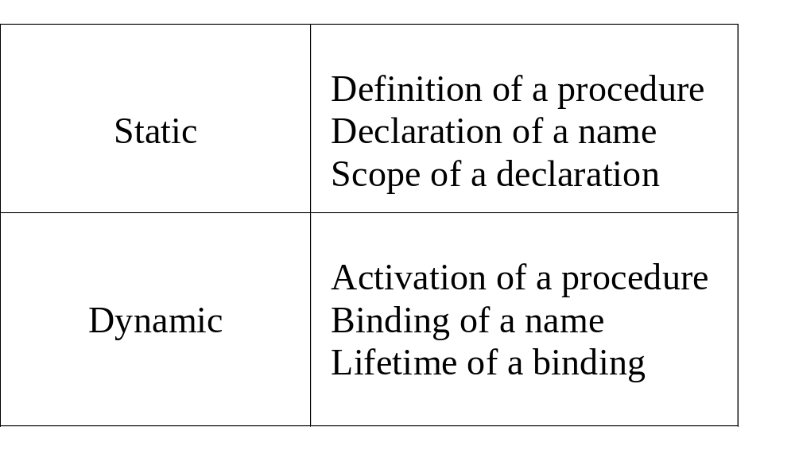
Static and Dynamic Notions

Slide 18
Storage Organization
code
Target code: static
Static data objects: static
Dynamic data objects: heap
Automatic data objects: stack
static data
stack
heap

Slide 19
Activation Records
returned value
stack
actual parameters
optional control link
optional access link
machine status
local data
temporary data

Slide 20
Activation Records
returned value and parameters
links and machine status
local and temporary data
returned value and parameters
links and machine status
frame pointer
local and temporary data
stack pointer

Slide 21
Declarations
P → {offset := 0} D
D → D “;” D
D → id “:” T {enter(id.name, T.type, offset);
offset := offset + T.width}
T → integer {T.type := integer; T.width := 4}
T → float {T.type := float; T.width := 8}
T → array “[” num “]” of T₁
{T.type := array(num.val, T₁.type);
T.width := num.val × T₁.width}
T → “*” T₁ {T.type := pointer(T₁.type);
T.width := 4}

Slide 22
Nested Procedures
P → D
D → D “;” D | id “:” T | proc id “;” D “;” S
header
nil
header
i
a
header
x
readarray
header
header
exchange
k
i
quicksort
v
j
partition

Slide 23
Symbol Table Handling
Operations
  mktable(previous): creates a new table and returns a pointer to the table
  enter(table, name, type, offset): creates a new entry for name in the table
  addwidth(table, width): records the cumulative width of entries in the header
  enterproc(table, name, newtable): creates a new entry for procedure name in the table
Stacks
  tblptr: pointers to symbol tables
  offset : the next available relative address

Slide 24
Declarations
P → M D {addwidth(top(tblptr), top(offset));
pop(tblptr); pop(offset)}
M → ε {t := mktable(nil); push(t, tblptr); push(0, offset)}
D → D “;” D
D → proc id “;” N D “;” S
{t := top(tblptr); addwidth(t, top(offset)); pop(tblptr);
pop(offset); enterproc(top(tblptr), id.name, t)}
D → id “:” T
{enter(top(tblptr), id.name, T.type, top(offset));
top(offset) := top(offset) + T.width}
N → ε {t := mktable(top(tblptr)); push(t, tblptr); push(0, offset)}

Slide 25
Records
T → record D end
T → record L D end
{T.type := record(top(tblptr));
T.width := top(offset);
pop(tblptr); pop(offset)}
L → ε
{t := mktable(nil);
push(t, tblptr); push(0, offset)}

Slide 26
New Names and Labels
Function newtemp returns a new name for each call
Function newlabel returns a new label for each call

Slide 27
Assignments
S → id “:=” E {p := lookup(id.name);
if p <> nil then emit(p ‘:=’ E.place)
else error}
E → E₁ “+” E₂ {E.place := newtemp;
emit(E.place ‘:=’ E₁.place ‘+’ E₂.place)}
E → E₁ “*” E₂ {E.place := newtemp;
emit(E.place ‘:=’ E₁.place ‘*’ E₂.place)}
E → “-” E₁ {E.place := newtemp;
emit(E.place ‘:=’ ‘-’ E₁.place)}
E → “(” E₁ “)” {E.place := E₁.place}
E → id {p := lookup(id.name);
if p <> nil then E.place := p
else error}

Slide 28
Array Accesses
A[i]:
base + (i - low) × w
⇒ (i × w) + (base - low × w)
A[i₁, i₂]:
base + ((i₁ - low₁) × n₂ + i₂ - low₂) × w
⇒ (((i₁×n₂) + i₂) × w) + (base - ((low₁×n₂) + low₂) × w)
c(id.place), width(id.place), limit(id.place, i)

Slide 29
Array Accesses
Use inherited attributes
L → id “[” Elist “]” | id
Elist → Elist “,” E | E
Use synthesized attributes
L → Elist “]” | id
Elist → Elist “,” E | id “[” E

Slide 30
Array Accesses
Elist → id “[” E
{Elist.place := E.place;
Elist.ndim := 1;
Elist.array := id.place
}
Elist → Elist₁ “,” E
{t := newtemp;
m := Elist₁.ndim + 1;
emit(t ‘:=’ Elist₁.place ‘*’ limit(Elist₁.array, m));
emit(t ‘:=’ t ‘+’ E.place);
Elist.array := Elist₁.array;
Elist.place := t;
Elist.ndim := m
}

Slide 31
Array Accesses
L → Elist “]”
{L.place := newtemp;
L.offset := newtemp;
emit(L.place ‘:=’ c(Elist.array));
emit(L.offset ‘:=’ Elist.place ‘*’ width(Elist.array))
}
L → id
{L.place := id.place;
L.offset := null
}

Slide 32
Array Accesses
E → L
{if L.offset = null then
E.place := L.place
else begin
E.place := newtemp;
emit(E.place ‘:=’ L.place ‘[’ L.offset ‘]’)
end}
S → L “:=” E
{if L.offset = null then
emit(L.place ‘:=’ E.place)
else
emit(L.place ‘[’ L.offset ‘]’ ‘:=’ E.place)
}

Slide 33
An Example
x := A[y, z]
n₁ = 10, n₂ = 20, w = 4
c = base_{A} - ((1 × 20) + 1) × 4 = base_{A} - 84
t1 := y * 20
t1 := t1 + z
t2 := c
t3 := t1 * 4
t4 := t2[t3]
x := t4

Slide 34
Type Conversion
E → E₁ + E₂
{E.place := newtemp;
if E₁.type = integer and E₂.type = integer then begin
emit(E.place ‘:=’ E₁.place ‘int+’ E₂.place);
E.type := integer
end else if E₁.type = real and E₂.type = real then begin
emit(E.place ‘:=’ E₁.place ‘real+’ E₂.place);
E.type := real
end else if E₁.type = integer and E₂.type = real then begin
u := newtemp;
emit(u ‘:=’ ‘inttoreal’ E₁.place);
emit(E.place ‘:=’ u ‘real+’ E₂.place);
E.type := real
end else if …
}

Slide 35
Flow-of-Control Statements
S → if E then S₁
| if E then S₁ else S₂
| while E do S₁
| switch E begin
case V₁: S₁
case V₂: S₂
…
case V_{n-1}: S_{n-1}
default: S_{n}
end

Slide 36
Conditional Statements
S → if E then S₁
{E.true := newlabel;
E.false := S.next;
S₁.next := S.next;
S.code := E.code
|| gen(E.true ‘:’)
|| S₁.code
}
E.true
E.code
E.false
E.true:
S₁.code
E.false:

Slide 37
Conditional Statements
S → if E then S₁ else S₂
{E.true := newlabel;
E.false := newlabel;
S₁.next := S.next;
S₂.next := S.next;
S.code := E.code
|| gen(E.true ‘:’)
|| S₁.code
|| gen(‘goto’ S.next)
|| gen(E.false ‘:’)
|| S₂.code
}
E.true
E.code
E.false
E.true:
S₁.code
goto S.next
E.false:
S₂.code
S.next:

Slide 38
Loop Statements
S → while E do S₁
{S.begin := newlabel;
E.true := newlabel;
E.false := S.next;
S₁.next := S.begin;
S.code :=
gen(S.begin ‘:’)
|| E.code
|| gen(E.true ‘:’)
|| S₁.code
|| gen(‘goto’ S.begin)
}
S.begin:
E.true
E.code
E.false
E.true:
S₁.code
goto S.next
E.false:

Slide 39
Boolean Expressions
E → E₁ or E₂ {E₁.true := E.true; E₁.false := newlabel;
E₂.true := E.true; E₂.false := E.false;
E.code := E₁.code || gen(E₁.false ‘:’) || E₂.code}
E → E₁ and E₂ {E₁.true := newlabel; E₁.false := E.false;
E₂.true := E.true; E₂.false := E.false;
E.code := E₁.code || gen(E₁.true ‘:’) || E₂.code}
E → not E₁ {E₁.true := E.false; E₁.false := E.true;
E.code := E₁.code}
E → “(” E₁ “)” {E₁.true := E.true; E₁.false := E.false;
E.code := E₁.code}
E → id₁ relop id₂
{E.code := gen(‘if’ id₁.place relop.op id₂.place
‘goto’ E.true) || gen(‘goto’ E.false)}
E → true {E.code := gen(‘goto’ E.true)}
E → false {E.code := gen(‘goto’ E.false)}

Slide 40
An Example
a < b or c < d and e < f
if a < b goto Ltrue
goto L1
L1: if c < d goto L2
goto Lfalse
L2: if e < f goto Ltrue
goto Lfalse

Slide 41
An Example
Lbegin: if a < b goto L1
goto Lnext
L1: if c < d goto L2
goto L3
L2: t1 := y + z
x := t1
goto Lbegin
L3: t2 := y - z
x := t2
goto Lbegin
Lnext:
while a < b do
if c < d then
x := y + z
else
x := y - z

Slide 42
Case Statements
Conditional goto’s
  less than 10 cases
Jump table
  more than 10 cases
  dense value range
Hash table
  more than 10 cases
  sparse value range

Slide 43
Conditional Goto’s
code to evaluate E into t
goto test
L1: code for S1
goto next
…
Ln-1: code for Sn-1
goto next
Ln: code for Sn
goto next
test: if t = V1 goto L1
…
if t = Vn-1 goto Ln-1
goto Ln
next:

Slide 44
Jump Table
code to evaluate E into t
if t < Vmin goto Ldefault
if t > Vmax goto Ldefault
i := t - Vmin
L := jumpTable[i]
goto L

Slide 45
Hash Table
code to evaluate E into t
i := hash(t)
L := hashTable[i]
goto L

Slide 46
Procedure Calls
S → call id “(” Elist “)”
{for each item p on queue do
emit(‘param’ p);
emit(‘call’ id.place)}
Elist → Elist “,” E
{append E.place to the end of queue}
Elist → E
{initialize queue to contain only E.place}

Slide 47
共勉
顏淵問仁。
子曰︰「克己復禮為仁。一日克己復禮，天下歸仁焉。
為仁由己，而由人乎哉？」
顏淵曰︰「請問其目？」
子曰︰「非禮勿視，非禮勿聽，非禮勿言，非禮勿動。」
顏淵曰︰「回雖不敏，請事斯語矣﹗」

